Slide 1



PYTHON PROGRAMMING COURSE
Error Handling in Python
Master the try and except Blocks
BBSHRRDB, PMU – ORIC, University of Sindh, Jamshoro, Pakistan.
Presented By:
TOPIC
Mr. Muhammad Yousif Memon
Error Handling in Python

Slide 2

Learning Objectives: Exceptions
Master the fundamentals of exceptions to build resilient Python applications.
Syntax vs. Runtime Errors
Understand the critical difference between syntax errors and runtime exceptions.
LEARNING GOALS & OBJECTIVES
Try-Except Execution Flow
Learn the syntax and execution flow of try, except, else, and finally blocks.
Targeted Error Catching
Discover how to catch specific exceptions to prevent application crashes.
Custom Exception Handling
Apply industry best practices for raising and handling custom error states.
Python Programming Course | Exception Handling & Application Resilience

Slide 3
Syntax Errors vs. Runtime Exceptions
Understanding the distinction between incorrect code construction and operational execution failures.
SYNTAX ERRORS
RUNTIME EXCEPTIONS
Invalid Code Construction
Operational Interruptions
Occur during parsing when the code violates Python's language rules. The interpreter cannot understand the program's structure.
Key Trait: The program cannot run at all. Execution is blocked entirely before starting.
Occur during execution when syntactically correct code encounters an operational issue that prevents it from finishing.
Key Trait: The program compiles and starts running, but crashes abruptly when the issue is hit.
>>> if True
print("Hello")
SyntaxError: expected ':'
>>> value = 10 / 0
ZeroDivisionError: division by zero
Common Causes: Missing colons, unclosed parentheses or brackets, mismatched quotes, or invalid indentation.
Common Examples: ZeroDivisionError (division by zero), TypeError (adding string to int), and FileNotFoundError (missing files).
Python Programming Course | Section 4: Errors and Exceptions

Slide 4

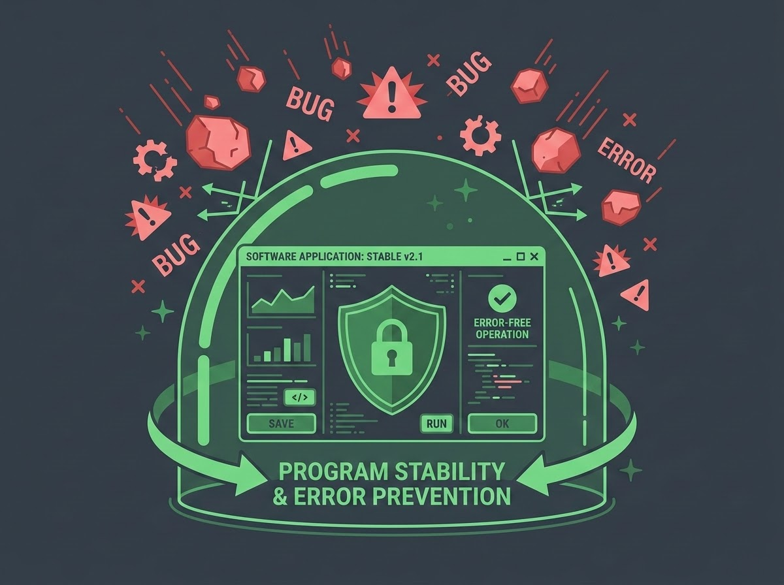
Introduction to Error Handling
Error handling ensures software reliability by gracefully managing unexpected runtime failures.
Prevents Application Crashes: Stops the entire program from terminating abruptly upon encountering a single, manageable error.
PROGRAM STABILITY & ERROR PREVENTION
Improves User Experience: Allows the application to display friendly, actionable error messages instead of exposing raw stack traces to the end user.
Enables Recovery Operations: Gives the program an opportunity to retry a failed network operation, utilize fallback data, or log the issue for developer debugging.
Error Handling in Python - The try and except blocks

Slide 5
The try-except Block
Intercept exceptions to allow the program to execute alternative logic.
TERMINAL CODE BLOCK
BLOCK MECHANICS
# Attempt division by zero
try:
result = 10 / 0
except ZeroDivisionError:
print("Cannot divide by zero!")
try block
Contains the specific lines of code that might raise an exception during execution.
except block
Contains the fallback code that executes only if an exception occurs within the try block.
RUNTIME EXECUTION FLOW
If an exception is raised inside the try block, execution immediately jumps to the except block, bypassing the rest of the try code to execute your alternative program logic safely.
Error Handling in Python - The try and except blocks

Slide 6
Targeted Exception Handling
Catching specific exceptions prevents masking unrelated bugs and allows targeted recovery.
Specify Exception Types: Always target specific errors (such as ValueError) rather than using an overly broad or bare statement.
TRY-EXCEPT IMPLEMENTATION
try:
num = int("abc")
except ValueError as e:
print(f"Invalid input detected: {e}")
# Output: Invalid input detected: invalid literal for int()
Avoid Bare Excepts: Catching everything can hide vital system exit calls and syntax errors, making debugging incredibly difficult during runtime.
WARNING: THE DANGER OF BARE EXCEPTS
Using a bare except: catches system exits, keyboard interrupts, and syntax bugs, preventing correct program termination and masking critical development mistakes.
Error Handling in Python — The try and except blocks

Slide 7
Handling Multiple Exceptions
Python allows handling different exceptions in distinct ways or grouping them together.
Sequential Multi-Catch Syntax
Exception Handling Concepts
try:
value = my_list[index] / divisor
except IndexError:
print("Index out of bounds.")
except (TypeError, ZeroDivisionError):
print("Math operation failed.")
Separate Blocks (Sequential Logic)
Chain multiple except blocks sequentially to handle different errors with unique, dedicated logic (e.g., catching IndexError specifically).
Tuple Grouping (Shared Handling)
Catch multiple related exception types in a single block using a tuple. This allows treating distinct failure modes, such as TypeError and ZeroDivisionError, with the same unified response logic.
Python Programming Course | Error Handling & Exception Propagation

Slide 8
The else Block in Exception Handling
Executing standard code safely only when no runtime errors are raised.
PYTHON CODE SNIPPET
BLOCK PURPOSE & CLARITY
try:
file = open("data.txt", "r")
except FileNotFoundError:
print("File missing.")
else:
print("File opened successfully!")
file.close()
Separating Execution Paths
Primary Purpose: Separates code that could fail from code that should strictly run only if the risky operation succeeds.
Code Clarity: Keeps the try block minimal, reducing the chance of accidentally catching exceptions from unrelated logic.
KEY TAKEAWAY
The else block executes only if the try block completes without raising any exceptions, strictly separating defensive error handling from successful execution logic.
Python Programming Course | Control Flow & Exception Handling

Slide 9
Guaranteed Execution with finally
The finally block executes unconditionally to ensure clean state and resource recovery.
CONNECTION CLEANUP CODE
STATE CLEANUP GUARANTEE
try:
db.connect()
db.execute_query()
finally:
db.disconnect() # Always runs
Unconditional Execution
Runs even if the try block succeeds, an exception is caught, or an unhandled exception propagates up.
Primary Use Case
Essential for resource management, such as closing files, releasing database connections, or freeing memory.
UNCONDITIONAL CLEANUP
The finally block guarantees execution regardless of whether an exception occurred or not, securing critical cleanup steps.
Error Handling in Python | The finally Block

Slide 10
Triggering Exceptions with raise
Use the raise keyword to intentionally trigger exceptions when invalid states are detected.
VALIDATION FUNCTION
EXCEPTION DESIGN & FLOW
# Define function with raise block validation
def set_age(age):
if age < 0:
raise ValueError("Age cannot be negative.")
return age
SIMULATED CALL & OUTPUT:
>>> set_age(-5)
ValueError: Age cannot be negative.
Proactive Validation
Raise errors immediately when functions receive invalid arguments or reach impossible logical states.
Flexible Customization
You can raise built-in Python exceptions or create custom exception classes by inheriting from the base Exception class.
Error Handling in Python - The raise Keyword

Slide 11


Handling Unknown Exceptions
When the exact exception type is unknown, use Python's base Exception class to safely capture errors.
RECOMMENDED SYNTAX
WHY USE "EXCEPT EXCEPTION AS E"?
try:
# Code that might raise an error
result = 10 / 0
except Exception as e:
# e stores the exact error message
print(f"An error occurred: {e}")
Catches All Standard Errors: Exception is the base class for almost all built-in Python exceptions, ensuring no unexpected crash.
Access to Error Details: Aliasing the error as e lets you print, log, or inspect the exact crash message dynamically.
Prevents Program Termination: Instead of crashing, your program handles the failure gracefully and continues execution.
Safe Alternative: Avoid using a bare except: clause, as it catches system-exits and keyboard interrupts, making code hard to stop.
KEY TAKEAWAY
Always prefer except Exception as e over bare except clauses to inspect error diagnostics without blocking system exit signals.
Python Programming Course | Exception Handling in Python

Slide 12
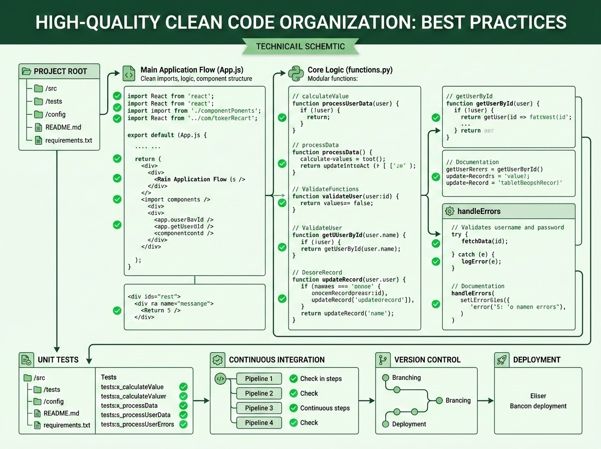
Best Practices for Exception Handling
Effective exception handling requires precision, minimal scope, and meaningful logging.
Be Specific: Catch precise exceptions; avoid catching the base Exception class unless logging at the top level of an application.
Clean Code Organization
Keep Try Blocks Small: Only wrap the exact lines of code that are expected to raise the targeted exception.
Log, Don't Print: Use Python's logging module to record error traces instead of printing to the standard console.
Fail Fast: Raise exceptions as soon as an invalid state is detected.
Error Handling in Python | Best Practices & Code Quality

Slide 13
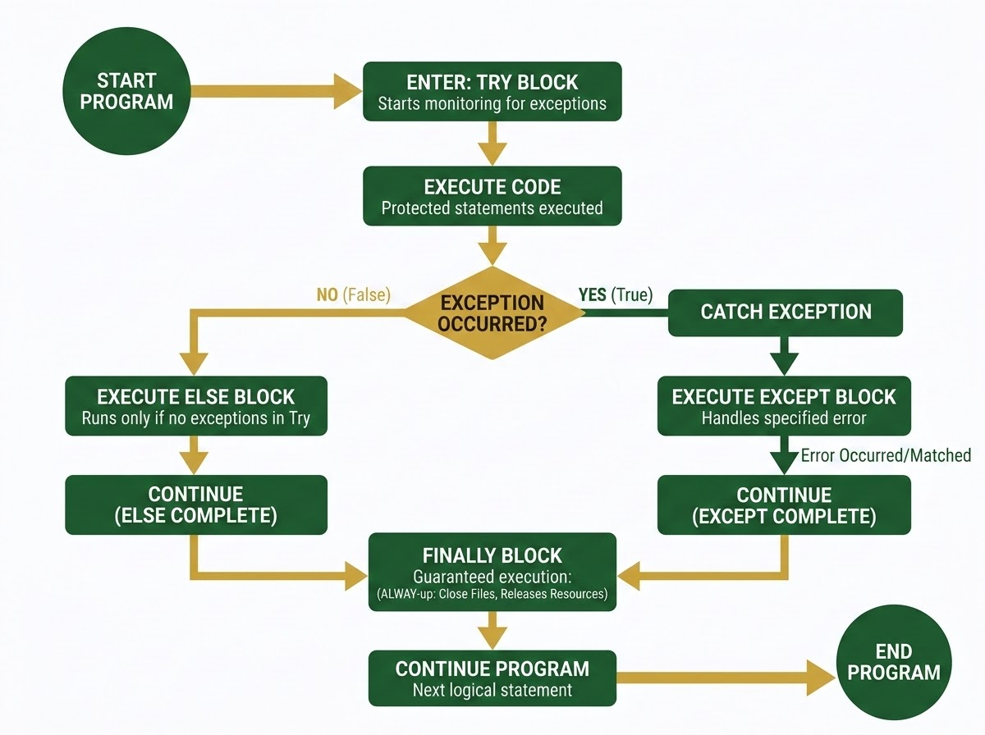
Resilient Exception Handling
The try-except-else-finally-raise structure provides a comprehensive framework for building resilient software.
try — Wraps risky code that may fail.
EXCEPTION FLOW LOGIC
except — Catches and handles specific runtime errors gracefully.
else — Executes dependent code only upon the success of the try block.
finally — Guarantees resource cleanup and teardown execution.
raise — Triggers custom error states to enforce business logic.
KEY TAKEAWAY
By integrating structured exception handling, software transitions from highly fragile operational profiles to clean, predictable, and exceptionally resilient execution states.
Python Programming Course | Control Flow & Resiliency

